Slide 1
Application of Stacks
By:
Vijaykumar R Pai
Shreedhar Hegde

Slide 2
Recursion
Definition
A recursive method solves a problem by calling a copy of itself to work on a smaller problem
Shorter, easier
Base case, Recursive case

Slide 3
Factorial of a Number

Slide 4
Iterative Function Pseudo code
prod = 1;
for(I = n; I > 0; I --)
prod *= I ;
return prod;
if (n < 0)
printf("Error! Factorial of a negative number doesn't exist");
else
{
for(i=1; i<=n; ++i)
{
factorial *= i;
}
printf("Factorial of %d = %llu", n, factorial);
}

Slide 5
Recursive Function
if n == 0
fact = 1;
else
return (n * fact(n-1))
int fact(int n)
{
int x, y;
if (n == 0)
return 1;
x = n-1;
y= fact(x);
return (n * y);
}

Slide 6
Program execution
Example using stack
In case of factorial of a number, iterative case is efficient than recursive case
In case of modern computers, there is no point in saying which is better

Slide 7
TOWER OF HANOI

Slide 8
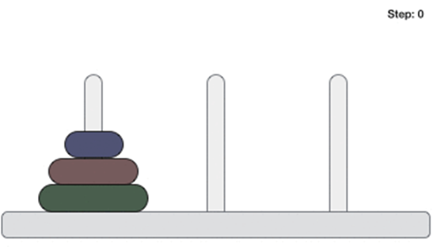
Definition and Concept
The Tower of Hanoi (also called the Tower of Brahma or Lucas' Tower) is a mathematical game or puzzle. It consists of three rods and a number of disks of different sizes, which can slide onto any rod. The puzzle starts with the disks in a neat stack in ascending order of size on one rod, the smallest at the top, thus making a conical shape.
The Tower of Hanoi puzzle was invented by the French mathematician Edouard Lucas in 1883.
The objective of the puzzle is to move the entire disks to another rod, obeying the following simple rules:
Only one disk can be moved at a time.
Each move consists of taking the upper disk from one of the rod and placing it on top of another rod.
No disk may be placed on top of a smaller disk.
With 3 disks, the puzzle can be solved in 7 moves. The minimal number of moves required to solve a Tower of Hanoi puzzle is 2^{n} − 1, where n is the number of disks.

Slide 9
Steps to move disk from one rod to an another :
Step 1 - Move n-1 disks from source to aux.
Step 2 - Move nth disk from source to dest
Step 3 - Move n-1 disks from aux to dest

Slide 10
Applications
The Tower of Hanoi is frequently used in psychological research on problem solving. There also exists a variant of this task called Tower of London for neuropsychological diagnosis and treatment of executive functions.
The Tower of Hanoi is also used as a Backup rotation scheme when performing computer data Backups where multiple tapes/media are involved.
The Tower of Hanoi is popular for teaching recursive algorithms to beginning programming students. A pictorial version of this puzzle is programmed into the emacs editor, accessed by typing M-x hanoi. There is also a sample algorithm written in Prolog.
The Tower of Hanoi is also used as a test by neuropsychologists trying to evaluate frontal lobe deficits.
In 2010, researchers published the results of an experiment that found that the ant species Argentine ant were successfully able to solve the 3-disk version of the Tower of Hanoi problem through non-linear dynamics and pheromone signals.

Slide 11
Pseudocode
START
Procedure Hanoi(disk, source, dest, aux)
IF disk == 1, THEN
move disk from source to dest
ELSE
Hanoi(disk - 1, source, aux, dest) // Step 1
move disk from source to dest // Step 2
Hanoi(disk - 1, aux, dest, source) // Step 3
END IF
END Procedure
STOP

Slide 12
Program
#include<stdio.h>
void Tower_Hanoi(int,char,char,char);
int main(void)
{
int n;
printf("Enter the number of disks:");
scanf("%d",&n);
Tower_Hanoi(n,'A','C','B');
return 0;
} /*end main*/

Slide 13
void Tower_Hanoi(int n, char frompeg, char topeg, char auxpeg)
{
/*If only one disk, make the move and return.*/
if(n==1)
{
printf("%s %c %s %c\n", "Move disk 1 from peg", frompeg, "to peg", topeg);
return;
} /*end if*/
/*Move top n-1 disks from A to B using C as auxiliary*/
Tower_Hanoi(n-1, frompeg, auxpeg, topeg);
/*Move remaining disk from A to C*/
printf("%s %d %s %c %s %c\n", "Move disk", n, "from peg", frompeg, "to peg", topeg);
/*Move n-1 disk from B to C using A as auxiliary*/
Tower_Hanoi(n-1, auxpeg, topeg, frompeg);
}
/*end Tower_Hanoi*/

Slide 14
Output
Enter the number of disks:3
Move disk 1 from peg A to peg C
Move disk 2 from peg A to peg B
Move disk 1 from peg C to peg B
Move disk 3 from peg A to peg C
Move disk 1 from peg B to peg A
Move disk 2 from peg B to peg C
Move disk 1 from peg A to peg C

Slide 15
Viva Questions
Which data structure can be used suitably to solve the Tower of Hanoi problem?
a) Tree b) Heap c) Priority queue d) Stack
Answer: d
2. What is the number of moves required in the Tower of Hanoi problem for k disks?
a) 2k – 1 b) 2k + 1 c) 2^{k} + 1
d) 2^{k} – 1
Answer: d

Slide 16
Merge Sort

Slide 17
Definition and concepts
Merge sort is also known as divide, conquer and combine because we need to divide the n-element array into two subarrays of size n/2 repeatedly until only one element of array is present and then sort the two subarrays recursively using merge sort and merge the two sorted sub-sequences to form the sorted array.
It was invented by John Von Neumann in 1945.
Merge sort is done in two ways:
Top-down implementation.
Bottom-up implementation.
Merge Sort is quite fast, and has a time complexity of O(n log n). It is also a stable sort, which means the "equal" elements are ordered in the same order in the sorted list.

Slide 18



How merge sort works
To understand merge sort, we take an unsorted array as the following −
We know that merge sort first divides the whole array recursively into equal halves unless the atomic values are achieved. We see here that an array of 8 items is divided into two arrays of size 4.
This does not change the sequence of appearance of items in the original. Now we divide these two arrays into halves.
We further divide these arrays and we achieve atomic value which can no more be divided.

Slide 19



We first compare the element for each list and then combine them into another list in a sorted manner. We see that 14 and 33 are in sorted positions. We compare 27 and 10 and in the target list of 2 values we put 10 first, followed by 27. We change the order of 19 and 35 whereas 42 and 44 are placed sequentially.
In the next iteration of the combining phase, we compare lists of two data values, and merge them into a list of found data values placing all in a sorted order.
After the final merging, the list should look like this −

Slide 20
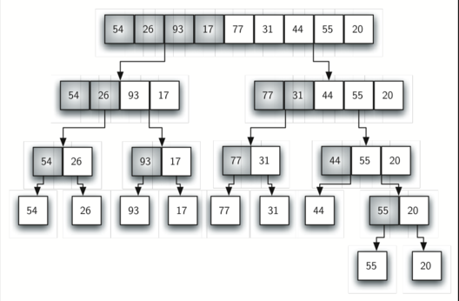
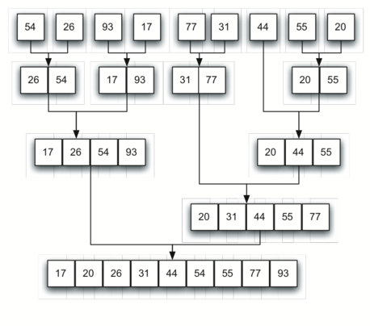

Slide 21
Applications of Merge sort
The e-commerce application
Have you ever noticed on any e-commerce website, they have this section of “You might like”, they have maintained an array for all the user accounts and then whichever has the least number of inversion with your array of choices, they start recommending what they have bought or they like. This is one of them.
And some e-commerce website like policybazaar.com, trivago.com etc use their search engine for collecting data from other website to provide minimum cost of booking hotel room or purchasing product.
Telephone Directory − The telephone directory stores the telephone numbers of people sorted by their names, so that the names can be searched easily.
Dictionary − The dictionary stores words in an alphabetical order so that searching of any word becomes easy.

Slide 22
Pseudocode
procedure mergesort( var a as array )
if ( n == 1 ) return a
var l1 as array = a[0] ... a[n/2]
var l2 as array = a[n/2+1] ... a[n]
l1 = mergesort( l1 )
l2 = mergesort( l2 )
return merge( l1, l2 )
end procedure
procedure merge( var a as array, var b as array )
var c as array

Slide 23
while ( a and b have elements )
if ( a[0] > b[0] )
add b[0] to the end of c
remove b[0] from b
else
add a[0] to the end of c
remove a[0] from a
end if
end while
while ( a has elements )
add a[0] to the end of c
remove a[0] from a
end while

Slide 24
while ( b has elements )
add b[0] to the end of c
remove b[0] from b
end while
return c
end procedure

Slide 25
Program
#include<stdio.h>
int arr[20]; // array to be sorted
int main()
{
int n,i;
printf("Enter the size of array\n"); // input the elements
scanf("%d",&n);
printf("Enter the elements:\n");
for(i=0;i<n;i++)
scanf("%d",&arr[i]);
merge_sort(arr,0,n-1); // sort the array

Slide 26
printf("Sorted array:"); // print sorted array
for(i=0;i<n;i++)
printf("%d\t\t",arr[i]);
return 0;
}
int merge_sort(int arr[],int low,int high)
{
int mid;
if(low<high)
{
mid=(low+high)/2;
// Divide and Conquer

Slide 27
merge_sort(arr,low,mid);
merge_sort(arr,mid+1,high);
// Combine
merge(arr,low,mid,high);
}
return 0;
}
int merge(int arr[],int l,int m,int h)
{
int arr1[10],arr2[10]; // Two temporary arrays to hold the two arrays to be merged
int n1,n2,i,j,k;
n1=m-l+1;
n2=h-m;

Slide 28
for(i=0;i<n1;i++)
arr1[i]=arr[l+i];
for(j=0;j<n2;j++)
arr2[j]=arr[m+j+1];
arr1[i]=9999; // To mark the end of each temporary array
arr2[j]=9999;
i=0;j=0;
for(k=l;k<=h;k++) //process of combining two sorted arrays
{
if(arr1[i]<=arr2[j])
arr[k]=arr1[i++];
else
arr[k]=arr2[j++];
}
return 0;
}

Slide 29
Expected Output
Enter the size of array : 8
Enter the elements:
14
33
27
10
35
19
42
44
Sorted array: 10 14 19 27 33 35 42 44

Slide 30
Viva Questions
1. What is the output of merge sort after the 1st pass given the following sequence of numbers: 25 57 48 37 12 92 86 33 a. 48 25 37 12 57 86 33 92 b. 12 25 33 37 48 57 86 92 c.12 25 33 37 48 57 86 92 d. 25 57 37 48 12 92 33 86
Ans:d
2. What is the output of merge sort after the 2nd pass given the following sequence of numbers : 3,41,52,26,38,57,9,49 a. 3,26,41,52,38,9,49,57 b. 3,26,41,52,9,38,49,57 c. 3,26,38,9,49,57,41,52 d. 3,26,41,52,38,49,57,9
Ans. b

Slide 31
3. What is the output of merge sort after the 3rd pass given the following sequence of numbers: 25 57 48 37 12 92 86 33 a. 12 25 33 37 48 57 86 92 b. 12 25 33 37 48 57 86 92 c.12 25 33 37 48 57 86 92 d. 25 57 37 48 12 92 33 86
Ans:a
4. You have to sort 1 GB of data with only 100 MB of available main memory. Which sorting technique will be most appropriate?
a. Heap sort b. Merge sort c. Quick sort d. Insertion sort
Ans:b

Slide 32
5. Which of the following is true about merge sort?
a. Merge Sort works better than quick sort if data is accessed from slow sequential memory
b. Merge Sort is stable sort by nature
c. Merge sort outperforms heap sort in most of the practical situations
d. All of the above
Ans:b
6. What is the best sorting algorithm to use for the elements in array are more than 1 million in general?
a. Merge sort
b. Bubble sort
c. Quick sort
d. Insertion sort
Ans:c

Slide 33
THANK YOU

